Slide 1
AI Powered SQL Query Generator
June-26
AIWeavers

Slide 2
Problem Statement
Target Audience
Technical Details
Cost
Future Enhancements
Lack of Flexible Data Source Integration
Manual SQL Querying is Complex
Integration
Adding new databases requires code changes
No simple way for users to connect their own data sources
Limits scalability and usability of applications
Writing SQL queries requires technical expertise
Non-technical users struggle to access data.
Errors in queries can lead to incorrect insights
SQL Querying
Natural Language Interface
Natural Language Interface
Users prefer asking questions in plain English.
Current systems lack seamless NL → SQL conversion
Inefficient Data Exploration
Data Exploration
Users depend heavily on developers for data access
Slows down decision-making and analytics workflows
There is a need for a system that simplifies data access by allowing users to connect their own data sources and generate SQL queries using natural language.

Slide 3
Problem Statement
Target Audience
Technical Details
Cost
Future Enhancements
Product Managers (PMs)
Need quick access to data for decision-making
Can generate insights without relying on technical teams
Product Owners (POs)
Validate product features using real-time data
Easily query databases to monitor KPIs
Business Analysts (BAs)
Perform data analysis without deep SQL expertise
Speed up reporting and insights generation
New Joinee / Freshers
Reduce onboarding time for understanding databases
Interact with data using natural language instead of SQL
Non-Technical Stakeholders
Leadership, operations, or sales teams
Access data without technical barriers
Developers / Data Engineers
Save time on writing repetitive queries
Focus on higher-value tasks
Designed for both technical and non-technical users to simplify and democratize data access.

Slide 4
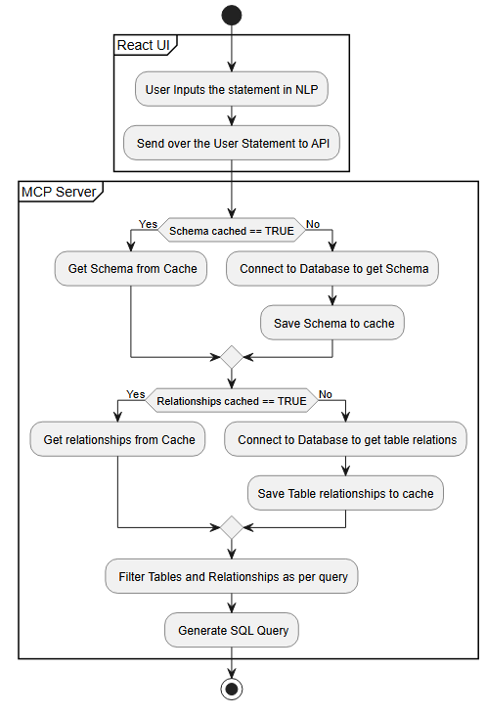
Problem Statement
Target Audience
Technical Details
Cost
Future Enhancements
The system follows a modular, service-based architecture
Core Functionality
Core Functionality Natural Language → SQL Conversion
Schema-aware query generation
Dynamic datasource support
Query optimization using caching
Key Components
Front End
Responsive React UI
Accepts User Texts and shows generated SQL
API Layer
Fast API (Python)
Handles request routing and orchestration
Tools
Python Tools to connect to DB
Open AI
GPT4o model to select tables and generate Queries

Slide 5
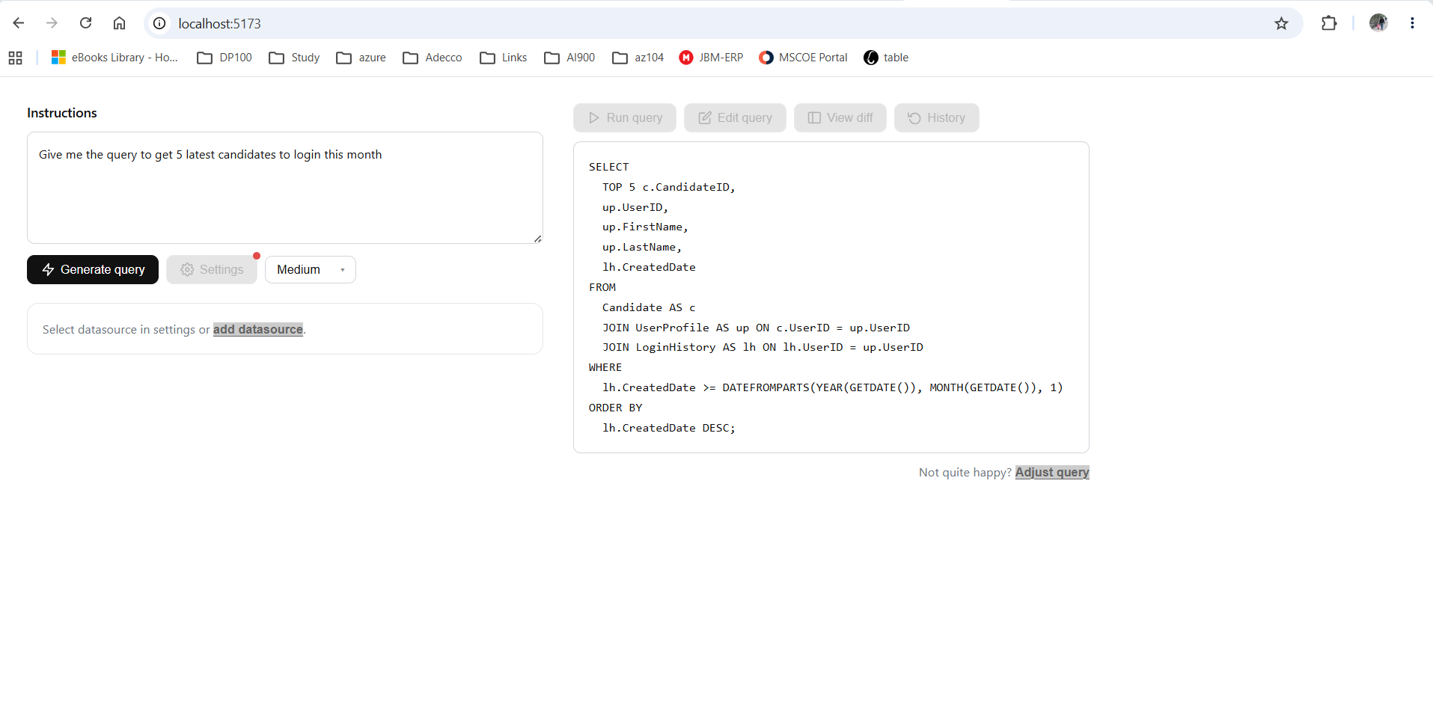
Problem Statement
Target Audience
Technical Details
Cost
Future Enhancements
Demo

Slide 6
Problem Statement
Target Audience
Technical Details
Cost
Future Enhancements
Azure GPT4o Cost Sheet
Input tokens: $5 per 1M tokens → $0.005 per 1K tokens
Output tokens: $15 per 1M tokens → $0.015 per 1K tokens
Token Usage / Generation
Input Tokens ~ 38 K
Output tokens ~ 150
Input Tokens ~ $0.1929
Output tokens ~ $0.0051
Cost / Generation
$0.1980

Slide 7
Problem Statement
Target Audience
Technical Details
Cost
Future Enhancements
Cost Optimization Planned
Cache embedding results for repeated queries
Implement schema chunking + vector DB
Identify the less-used/ non-relevant columns
Remove duplicates before sending to LLM and Flatten relations
Create Compact Json instead of Text for Schema data
Projected Cost / Generation
Input Tokens ~ 20K ~ $0.098
Output tokens ~ $0.0051
$0.1031
Optimizations will reduce the Token cost by ~60%

Slide 8
Problem Statement
Target Audience
Technical Details
Cost
Future Enhancements
Query Execution & Editing
Execute generated SQL directly on connected data source
Allow users to modify and refine generated SQL
Compare original vs modified queries
Customization & Data Interaction
Customize query generation parameters
Control LLM behavior (complexity, format, filters)
Export results (CSV / Excel)
Query Management
History Track previously generated queries
Reuse past queries for faster workflows
The platform is designed to evolve with advanced capabilities for execution, customization, and analytics.

Slide 9
Let’s Engage

